Slide 1


Sell Car
Use Case

Slide 2
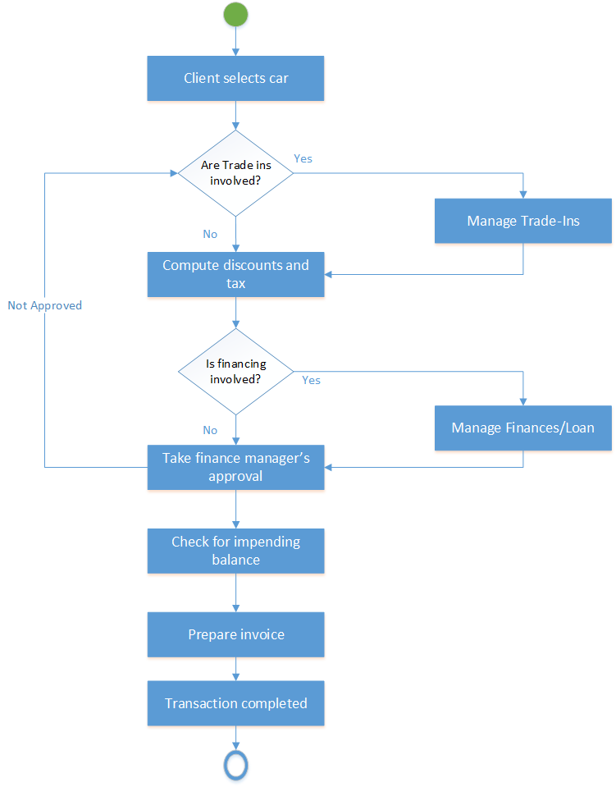
Sell Car
Activity Diagram

